Slide 1
Drawing Monsters – 15% Solutions – Troika Consulting - Improv Prototyping – Discovery and Action Dialog What, So What, Now What?
Nancy White
Full Circle Associates
http://www.fullcirc.com
A Liberating Structures String

Slide 2
“Um, I’m not so sure about …” Drawing Monsters (a punctuation)
From Lynda Barry
https://www.drawnandquarterly.com/syllabus and http://thenearsightedmonkey.tumblr.com/search/syllabus
What do we fear? How can we use that fear as a way to discover what to do next? To engage the ideas/skills/energy of those around us in those next steps? This Liberating Structure string riffs on Lynda Barry’s fabulous Drawing Monsters, turning it into a “punctuation” for other LS. In LS terminology, a punctuation is something that creates a moment of reflection or connection between two or more Liberating Structures.

Slide 3
Drawing Monsters
Take an 8 1/2 x 11 inch piece of paper. It's better if it's a piece of paper you were planning to throw away. Use the blank back side!
Fold it into four quarters, so it's divided into four chambers.

Slide 4
Drawing Monsters
Take a pencil or a pen. On one chamber, make a squiggle.
On another chamber, make a closed shape, like a square or a rhombus.
On the third quarter, make another squiggle.
On the fourth quarter, go crazy… just make a mark to start!

Slide 5
Drawing Monsters
Turn your squiggles and shapes into monsters. You know, eyeballs, teeth, claws, etc. Repeat for all four chambers.

Slide 6
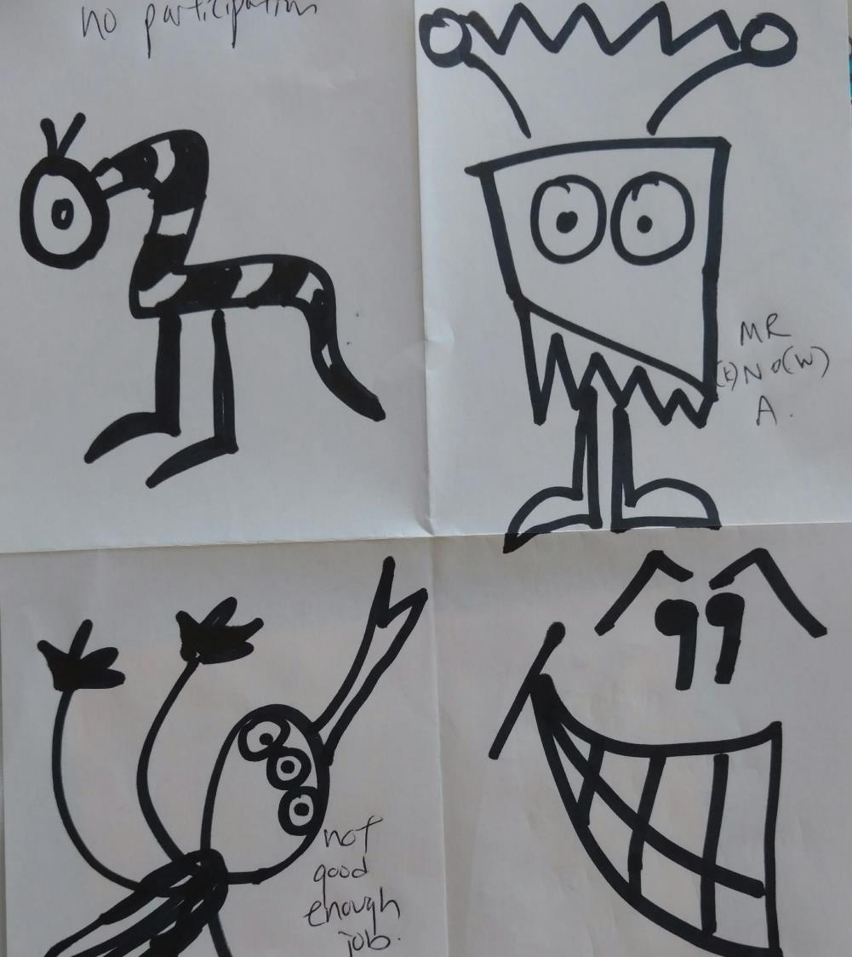
Name Your Monsters: Is this the horse you fell off of (or are afraid of?)
Make a list of things that most worry you about the challenge at hand. (For example, when teaching others about LS, there are many initial fears, like being afraid to ask for permission to use LS, if something goes really wrong, offered a weak invitation, have a strong impulse to keep “presenting”, fear of stringing).
Prioritize the 4 most scariest, awfullest, most intimidating things.
Look at that list. Figure out which monster represents each fear.
Write those fears above those monsters. It's an instant comic and the results are often hilarious.

Slide 7
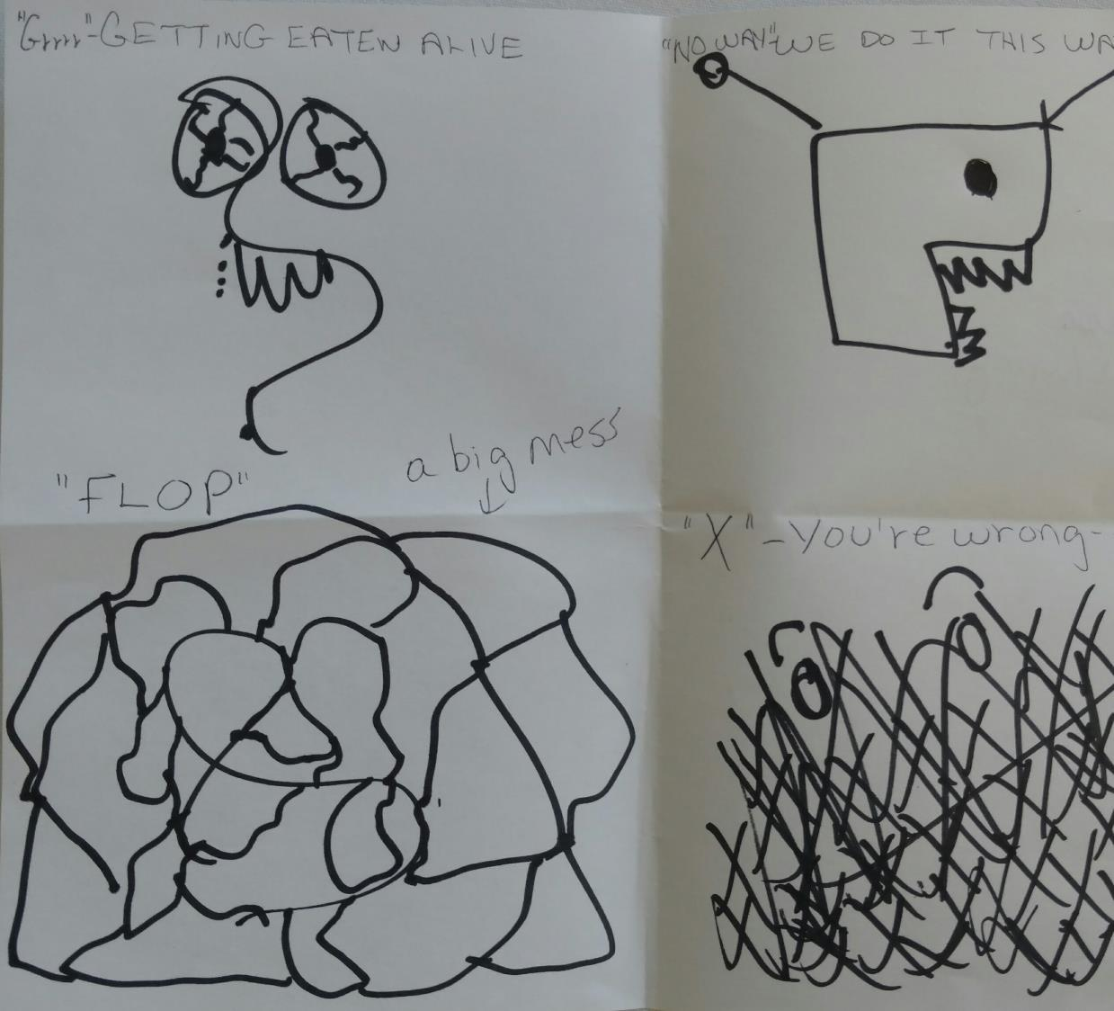
Address Your Monsters: Options
15% Solution/Troika Consulting
Improv Prototyping
Discovery and Action Dialog

Slide 8
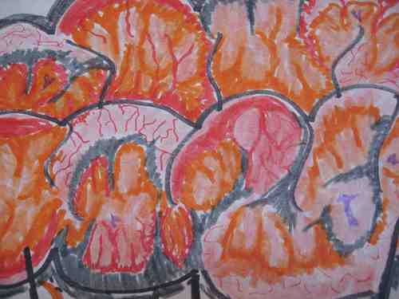
The 15% solution
Noticing and using the influence, discretion and power individuals have right now.
– Keith McCandless
http://www.liberatingstructures.com/7-15-solutions/
Notes:
Note:
“Where is your 15%?” Where do you have discretion and freedom to act?”
Mention because so many teachers feel they don’t have this power
8

Slide 9
15% Insights on Our Monsters
Always there for the asking (and taking)
Most unused or unnoticed source of influence
BIG things may emerge via Butterfly effect
Reinventing the wheel is OK
Each 15% solution adds to your understanding of what is possible
Clear, common purpose and boundaries generate coherence among many solutions
Energizing, motivating and liberating

Slide 10
15% Solutions (With Troika)
Invitation
What is your 15% solution for your monster
Space, Materials
Step Sequence
Chairs for (unlimited number of) groups of 3
Generate 15% solution alone then address via Troika Consulting
15% Solutions
Discover and focus on what you have freedom/resources to do now
Participation Distributed
Groups Configured
1-3 (plus many options)
Everyone included with equal opportunity to contribute
Notes:
Discover and Focus on What Each Person Has the Freedom and Resources to Do Now (20 min.)
You cannot cross the sea merely by standing and staring at the water. – R. Tagore
What is made possible? You can reveal the actions, however small, that everyone can do immediately. At a minimum, these will create momentum, and that may make a BIG difference. 15% Solutions show that there is no reason to wait around, feel powerless, or fearful. They help people pick it up a level. They get individuals and the group to focus on what is within their discretion instead of what they cannot change. With a very simple question, you can flip the conversation to what can be done and find solutions to big problems that are often distributed widely in places not known in advance. Shifting a few grains of sand may trigger a landslide and change the whole landscape.
Five Structural Elements – Min Specs
1. Structuring Invitation
In connection with their personal challenge or their group’s challenge, ask, “What is your 15 percent? Where do you have discretion and freedom to act? What can you do without more resources or authority?”
2. How Space Is Arranged and Materials Needed
Unlimited number of groups.
Chairs for people to sit in groups of 2-4; no tables required.
3. How Participation Is Distributed
Everyone is included
Everyone has an equal opportunity to contribute
4. How Groups Are Configured
First alone
Then in pairs or small groups
5. Sequence of Steps and Time Allocation
First alone, each person generates his or her own list of 15% Solutions. 5 min.
Individuals share their ideas with a small group (2 to 4 members). 3 min. per person and one person at a time
Group members provide a consultation to one another (asking clarifying questions and offering advice). 5 to 7 min. per person and one person at a time
WHY? Purposes
Move away from blockage, negativism, and powerlessness
Have people discover their individual and collective power
Reveal bottom-up solutions
Share actionable ideas and help one another
Build trust
Remember unused capacity and resources (15 percent is always there for the taking)
Reduce waste
Close the knowing-doing gap
Tips and Traps
Check each item to assure that it is within the discretion of the individual
Be ready for BIG things to emerge via the butterfly effect
Reinventing the wheel is OK
Each 15% Solution adds to understanding of what is possible
Clear, common purpose and boundaries will generate coherence among many 15% Solutions
Make it a routine to ask for 15% Solutions in meetings (15% Solutions are otherwise commonly unnoticed and overlooked)
While introducing the idea, tell a story about a small change made by an individual that sparked a big result
Learn more from professor Gareth Morgan, who has popularized the concept at www.imaginiz.com/index.html under the tab Provocative Ideas
Riffs and Variations
Natural fit with Troika Consulting, Wise Crowds, Open Space, Helping Heuristics, and Integrated~Autonomy
Returning to a group, you can ask, “What have you done with your 15 percent lately?”
Examples
For any problem-solving or planning activity in which you want individuals to take initiative
For inclusion in the conveners report in Open Space sessions
For any challenge that requires many people to change for success to emerge
For generating small “chunks” of success that can be combined into a simple prototype that is easy and cheap to test (low-fidelity prototype)
Attribution: Liberating Structure developed by Henri Lipmanowicz and Keith McCandless. Inspired by professor Gareth Morgan.

Slide 11
Troika Consulting

Slide 12
Troika Consulting Get practical and imaginative help from colleagues immediately
Client share your monster picture + 15% solution idea and any challenges or questions you have about it.
Consultants ask clarifying questions (not discussions or feedback!)
Client turns back with pen/paper in hand. Listen. No participating!
Consultants discuss challenge...reframe, generate ideas, expand solutions…
Client thanks consultants, and if applicable, shares the most important insight or next step (i.e. what they are going to do with their monster!)
Switch Client. Repeat. Switch Client. Repeat third time.
Notes:
Pixie option for the final round.

Slide 13
Troika Consulting (building off of 15% Solutions)
Invitation
What’s your challenge? What kind of help do you need?
Space, Materials
Step Sequence
Groups of three chairs, no tables!
Share challenge, clarifying questions, turn back and listen.
Troika Consulting
Get immediate help w/ your challenge
Participation Distributed
Groups Configured
Groups of 3
Diversity is great!
In each round 1 is client, 2 are consultants. All equal oppty. to receive/give consulting
Notes:
Get Practical and Imaginative Help from Colleagues Immediately (30 min.)
To listen is very hard, because it asks of us so much interior stability that we no longer need to prove ourselves by speeches, arguments, statements or declarations. True listeners no longer have an inner need to make their presence known. They are free to receive, welcome, to accept. – Henri Nouwen
What is made possible? You can help people gain insight on issues they face and unleash local wisdom for addressing them. In quick round-robin “consultations,” individuals ask for help and get advice immediately from two others. Peer-to-peer coaching helps with discovering everyday solutions, revealing patterns, and refining prototypes. This is a simple and effective way to extend coaching support for individuals beyond formal reporting relationships. Troika Consulting is always there for the asking for any individual who wishes to get help from colleagues or friends.
Five Structural Elements – Min Specs
1. Structuring Invitation
Invite the group to explore the questions “What is your challenge?” and “What kind of help do you need?”
2. How Space Is Arranged and Materials Needed
Any number of small groups of 3 chairs, knee-to-knee seating preferred. No table!
3. How Participation Is Distributed
In each round, one participant is the “client,” the others “consultants”
Everyone has an equal opportunity to receive and give coaching
4. How Groups Are Configured
Groups of 3
People with diverse backgrounds and perspectives are most helpful
5. Sequence of Steps and Time Allocation
Invite participants to reflect on the consulting question (the challenge and the help needed) they plan to ask when they are the clients. 1 min.
Groups have first client share his or her question. 1-2 min.
Consultants ask the client clarifying questions. 1-2 min.
Client turns around with his or her back facing the consultants
Together, the consultants generate ideas, suggestions, coaching advice. 4-5 min.
Client turns around and shares what was most valuable about the experience. 1-2 min.
Groups switch to next person and repeat steps.
WHY? Purposes
Refine skills in asking for help
Learn to formulate problems and challenges clearly
Refine listening and consulting skills
Develop ability to work across disciplines and functional silos
Build trust within a group through mutual support
Build capacity to self-organize
Create conditions for unimagined solutions to emerge
Tips and Traps
Invite participants to form groups with mixed roles/functions
Suggest that participants critique themselves when they fall into traps (e.g., like jumping to conclusions)
Have the participants try to notice the pattern of support offered. The ideal is to respectfully provoke by telling the client “what you see that you think they do not see”
Tell participants to take risks while maintaining empathy
If the first round yields coaching that is not good enough, do a second round
Beware that two rounds of 10 minutes per client is more effective than one round of 20 minutes per client.
Keep the spaces safe: if you share anything, do it judiciously
Questions that spark self-understanding or self-correction may be more powerful than advice about what to do
Tell clients to try and stay focused on self-reflection by asking, “What is happening here? How am I experiencing what is happening?”
Make Troika Consulting routine in meetings and conferences
Riffs and Variations
Meld with 15% Solutions: each client shares a 15% Solution, asking for coaching
Inviting the client to turn around and sit facing away from his or her consultants once the question has been shared and clarified deepens curiosity, listening, empathy, and risk taking for all. The alternative of not turning around is an option.
Restrict the coaching to generating only questions to clarify the challenge: no advice giving (aka Q-Storming)
String together with Helping Heuristics; Heard, Seen, Respected; Nine Whys
Examples
For the beginning or end of staff meetings
After a presentation, for giving participants time to formulate and sift next steps
For students to help one another and to promote peer-to-peer learning
In the midst of conferences and large-group meetings
As a self-initiated practice within a group
Attribution: Liberating Structure developed by Henri Lipmanowicz and Keith McCandless.

Slide 14
Improv Prototyping

Slide 15
Improv Prototyping: Setting the Stage
You have identified your (whatever topic) monster. You feel brave today and decide to bring it up with …. You are feeling brave today. ;-)
The fear you are facing is a chronic problem
You have tried everything
You have decided, “I will NOT give up! Instead, I will try something new.”
Players: … volunteers embraced!

Slide 16
Rules for the Players/Directors
Players
Trust & accept all offers (“Yes, and…”)
Make action-filled choices, giving and taking
Engage in one conversation at a time
Listen, watch, concentrate (Look, don’t think!)
Work to the top of your intelligence
Tap out option
Creative Director
Start/stop the scene to reply or revise the action
Give feedback on verbal and non verbal responses
Consider the Four Helping Heuristics:
Quiet presence
Guided discovery
Kind provocation
Generative shaping

Slide 17
Improv Prototyping
Invitation
Invite participants to identify a frustrating chronic challenge in their work, then to playfully experiment, invent, and discover better ways to address the challenge by acting out the situation and possible solutions.
Space, Materials
Set the stage/describe scenario
Players enact scene
Small observer groups debrief +/-
Groups piece successful “chunks” into new prototype
Volunteers act out the new
Continue rounds to arrive 1+ prototypes good enough to put into practice.
Step Sequence
An open space or stage at the front or in the middle of a room
If needed, props for the scene or scenes to be offered
Small clusters of chairs to accommodate all participants
Improv Prototyping
Key value
Participation Distributed
Groups Configured
Everyone is included either as players or observers
A few volunteers to be “players”
Everyone else acts as observers and evaluators, then co-creative players
One small group of players on “the stage”
All others, the observers, in small groups in front or around the stage
Notes:
Develop Effective Solutions to Chronic Challenges While Having Serious Fun (20 min. per round)
To be playful is not to be trivial or frivolous, or to act as if nothing of consequence will happen. On the contrary, when we are playful with one another, we relate as free persons, and the relationship is open to surprise; everything that happens is of consequence, for seriousness is a dread of the unpredictable outcomes of open possibility. To be serious is to press for a specified conclusion. To be playful is to allow for unlimited possibility. – James Carse
What is made possible? You can engage a group to learn and improve rapidly from tapping three levels of knowledge simultaneously: (1) explicit knowledge shared by participants; (2) tacit knowledge discovered through observing each other’s performance; and (3) latent knowledge, i.e., new ideas that emerge and are jointly developed. This powerful combination can be the source of transformative experiences and, at the same time, it is seriously fun. Participants identify and act out solutions to chronic or daunting problems. A diverse mix of people is invited to dramatize simple elements that work to solve a problem. Innovations represented in the Improv sketches are assembled incrementally from pieces or chunks that can be used separately or together. It is a playful way to get very serious work done!
Sources of Knowledge & Innovation, adapted from Alan Duncan, MD (Mayo Clinic), designed for VHA Health Foundation (2006).
Five Structural Elements – Min Specs
1. Structuring Invitation
Invite participants to identify a frustrating chronic challenge in their work, then to playfully experiment, invent, and discover better ways to address the challenge by acting out the situation and possible solutions.
2. How Space Is Arranged and Materials Needed
An open space or stage at the front or in the middle of a room
If needed, props for the scene or scenes to be offered
Small clusters of chairs to accommodate all participants
3. How Participation Is Distributed
Everyone is included either as players or observers
A few volunteers to be “players”
Everyone else acts as observers and evaluators, then co-creative players
4. How Groups Are Configured
One small group of players on “the stage”
All others, the observers, in small groups in front or around the stage
5. Sequence of Steps and Time Allocation
Explain what will be done and describe the sequence of steps. 2 min.
Set the stage by describing the scenario that will be acted out and the various roles. 3 min.
Players on stage enact the scene. 3–5 min.
Each small observer group debriefs with 1-2-4-All to identify successful and unsuccessful “chunks” from the scene that they just observed. 5 min.
Each observer group then pieces together the successful chunks into a new prototype and volunteers from within the group act out the new prototype for their own group only. 5 min.
Participants from one of the observer groups who judge that they have an improved prototype volunteer to come on stage and enact their version in front of the whole group. 3–5 minutes.
Continue with as many rounds as necessary to arrive at one or more prototypes that are good enough to put into practice.
WHY? Purposes
Enable people to act their way into new thinking: Improv Prototyping is a rehearsal for real life
Break a task that seems daunting into smaller pieces
Engage and focus everyone’s imagination on solving messy challenges
Break through frozen or resistant behaviors
Create an engaging and fun alternative to dry or unproductive training
Work across functional and disciplinary barriers
Help people learn from peers that have behaviors that solve the problem
Tips and Traps
Be as inclusive as possible: invite everyone in different roles to join in
Draw meaningful themes and dramatic lines for each scene from Discovery & Action Dialogues and Simple Ethnography
Consider creating three supporting roles depending on the complexity of the scenario: stage manager, creative director, and facilitator.
Replay scenes that do not capture the imagination or generate new ideas
Invite people to let go of assumptions and biases by putting themselves in the shoes of others, e.g., doctor plays nurse and nurse plays doctor, student plays professor
Invite creative director to gently redirect the players as needed
Riffs and Variations
With the goal of discovering better (and worse) actions, invite the audience to replay the scene in small groups. Start with separate small groups staging their own impromptu Improvs, then invite face-off competitions judged by an “applause-o-meter”
Link to and string with Design StoryBoards, Shift & Share, and User Experience Fishbowl to help spread the innovations (specify what is and what could be)
Examples
Hospital trainers have substituted Improv Prototyping for conventional courses
For sales reps to invent new ways to interact with their customers
For managers to make their interactions with people who report to them more productive
For health-care providers to practice end-of-life and palliative-care conversations with patients and family members
For teachers to discover effective responses to disruptive classroom behaviors
For training young nurses to stand their ground on safety issues (see “Dramatizing Behavior Change to Stop Infections” in Part Three: Stories from the Field).
Attribution: Liberating Structure developed by Henri Lipmanowicz and Keith McCandless. Inspired by Antonas Mockus (former mayor of Bogota) and Improv artists.
Collateral Material

Slide 18
Discovery & Action Dialog

Slide 19
Designing our future(s) with Discovery and action dialog
Purpose: Identify potential actions and next steps
With options surfaced in our crowdsourcing (and any additional ideas) form groups to work on one idea.
Return to plenary by __ with a one page summary and someone who will ‘person’ your ‘stand’
Gallery walk to consider ideas
Plenary discussion

Slide 20
Discovery and Action Dialogue Discover, spark and unleash local solutions to chronic problems
Seven Powerful Questions:
How do you know when people are not speaking up and differences are swept under the rug?
How do YOU contribute effectively to working productively with differences?
What prevents you from doing this or taking these actions all the time?
Is there anyone you know who is able to frequently draw out every voice and productively work with differences? How?
Do you have any ideas?
What needs to be done to make it happen? Any volunteers?
Who else needs to be involved?
Notes:
Modify with your own questions

Slide 21
Discovery and Action Dialogue Discover, spark and unleash local solutions to chronic problems
Steps
Form a group of 6-8
Select a facilitator and recorder
Clarify purpose of the dialogue
Start asking the questions in order
Debrief what happens…

Slide 22
Core Questions & Their Purpose
How do you know when ____the problem is present? | ~ Affirm the participant’s existing knowledge of the problem ~ Provide opportunities to get questions on the table
How do YOU contribute effectively to _______ solving the problem? | ~ Focus on personal practices, NOT on what other people don’t do ~ Amplify/confirm the participant’s knowledge of effective practices
What prevents you from doing this or taking these actions all the time? | ~ Identify real barriers and constraints to the effective behavior ~ What prevents you? identifies barriers rather than Why don’t you? which sounds judgmental
Is there anyone you know who is able to frequently ______ solve the problem, overcoming barriers? How? | ~ Establish that getting around barriers is possible ~ Identify the existing-but-uncommon successful strategies ~ Spark curiosity and inventiveness
Do you have any ideas? | ~ Identify the supports that make the desired behavior more likely ~ Provide an opportunity for participants to generate and share new ideas for enabling the desired behavior
What needs to be done to make it happen? Any volunteers? | ~ Identify action steps, target dates & feedback loops for metrics ~ Invite volunteers for each action step (capture ideas that don’t yet have an identified action plan or volunteer in your “butterfly” net.
Who else needs to be involved? | ~ Widen the circle of people involved in discovering and inventing solutions, drawing in unusual suspects
Notes:
DAD

Slide 23
Facilitation Tips
Do:
Start with the purpose, We are here to stop/start __________!
“Give” questions back to the group, wait at least 20 seconds for a response (looking at your shoes can help!)
Encourage quiet people to talk
Flip cynical assertions by asking, “If I understand you correctly, no one has ever done this successfully or well!”
Work through all the questions without worrying about the order: the dialogue WILL be non-linear
Maintain humility, you “sit at the feet” of people with solutions
Do not:
Answer questions that have not been asked directly to you
Miss opportunities to “catch butterflies” – record actions to be taken by participants (NOT YOU) as they pop up
Come away with a to-do list for yourself
Decide about me without me… instead invite “them” into the next dialogue
Respond positively or negatively to contributions, instead the group sift through their own assessments (e.g., ask, “How do others think or feel about this suggestion?”
Notes:
y

Slide 24
DaD
Invitation
Uncover tacit or latent solutions to shared challenges
Space, Materials
Unlimited number of groups, chairs, paper, flip chart
Step Sequence
State purpose of initiative, introductions. Ask 7 questions in order. Recap.
DaD
Discover, Invent, and Unleash Local Solutions to Chronic Problems
Groups Configured
Facilitator, groups 5-15, diversity of roles
Facilitator intro’s question, everyone is included and can contribute
Participation Distributed
Notes:
Discover, Invent, and Unleash Local Solutions to Chronic Problems (25-70 min.)
Live the questions now and perhaps without knowing it you will live along someday into the answers. – Rainier Maria Rilke
What is made possible? DADs make it easy for a group or community to discover practices and behaviors that enable some individuals (without access to special resources and facing the same constraints) to find better solutions than their peers to common problems. These are called positive deviant (PD) behaviors and practices. DADs make it possible for people in the group, unit, or community to discover by themselves these PD practices. DADs also create favorable conditions for stimulating participants’ creativity in spaces where they can feel safe to invent new and more effective practices. Resistance to change evaporates as participants are unleashed to choose freely which practices they will adopt or try and which problems they will tackle. DADs make it possible to achieve frontline ownership of solutions.
Five Structural Elements – Min Specs
1. Structuring Invitation
Invite people to uncover tacit or latent solutions to a shared challenge that are hidden among people in their working group, unit, or community. Ask anybody interested in solving the problem to join a small group and participate in a DAD. In the group, ask seven progressive questions:
How do you know when problem X is present?
How do you contribute effectively to solving problem X?
What prevents you from doing this or taking these actions all the time?
Do you know anybody who is able to frequently solve problem X and overcome barriers? What behaviors or practices made their success possible?
Do you have any ideas?
What needs to be done to make it happen? Any volunteers?
Who else needs to be involved?
2. How Space Is Arranged and Materials Needed
DADs take place in a local setting or unit
Groups may be standing or sitting around a table
Paper, flip chart, or software/projection equipment needed to record insights and actions
3. How Participation Is Distributed
Facilitator introduces the questions
Everyone who is around is invited to join and be included
Everyone in the group has an equal opportunity to contribute
4. How Groups Are Configured
Facilitator works with a partner to serve as a recorder
Group size can be 5–15 people
Diversity in roles and experience is an important asset
5. Sequence of Steps and Time Allocation
State the purpose of the initiative being discussed and the DAD and invite brief round-robin introductions. 5 min.
Ask the 7 questions one by one in the order given in the Invitation. Address them to the whole group and give everyone the opportunity to speak to each question. Make sure your recorder captures insights and action ideas as they emerge—big ones may emerge when you least expect it. 15–60 min.
Ask your recorder to recap insights, action ideas, and who else needs to be included. 5 min.
WHY? Purposes
Engage frontline people in finding solutions to thorny challenges
Discover tacit and latent behaviors and practices that are positively deviant from the norm
Spark the emergence of new solutions
Inspire rather than compel behaviors that solve complex problems
Generate changes that are sustained because they are discovered and invented by the people doing the work, rather than imported and imposed
Solve local problems locally and spread momentum across units
Build relationships between people in diverse functions and levels that otherwise don’t work together to solve problems
Tips and Traps
Question #2 often consists of two parts: how the problem affects the individual personally and how it affects others. For instance, “What do you do to protect yourself from infections and what do you do to prevent infection transmissions?” or “What do you do to keep your students engaged and what do you to keep yourself energized and enthusiastic?”
Hold the DADs where the participants work to minimize obstacles for participation
Make impromptu invitations for people to join in as you enter the area
Create an informal “climate,” starting with introductions and an anecdote if appropriate
Maintain eye contact and sit with the group (not higher or away from the group)
Be sure you talk much less than participants, encouraging everyone to share stories and “sift” for action opportunities
Dramatizing Behavior Change to Stop Infections” in Part Three: Stories from the Field
Notice when you form judgments in your head about what is right or wrong, then count to ten and “let it go” before you say anything (you may need to ask for the help of your recorder or a facilitator colleague)
Avoid statements like “that’s a good idea” and leave space for participants to make their own assessments
Demonstrate genuine curiosity in everyone’s contributions without answering the questions yourself: study at the feet of the people who do the work
Do not give or take assignments!
Don’t judge yourself too harshly: it takes practice to develop a high level of skill with this approach to facilitation. Be sure to ask your recorder for direct feedback.
Riffs and Variations
Use TRIZ-like questions instead of the first three, namely: (1) What can you do to make sure that problem X becomes much worse? (2) Is there anything you are doing that in any way, shape, or form looks like any of the practices you just listed? (3) What is preventing you from stopping these practices?
Use insights and barriers that surface to develop scripts for Improv Prototyping scenes and organize Improv sessions
Use the same sequence and type of questions to guide one-on-one conversations
With virtual groups, use the chat function to share answers to each question, then select powerful stories/behaviors/actions to be vocalized with the whole group
Examples
For reducing harm to patients experiencing safety lapses (e.g., wrong-side surgery, patient falls, medication errors, iatrogenic infections) with cross-functional groups. Video of a DAD in progress to reduce the transmission of infections from UHN in Toronto.
For use as an ethnographic data-collection tool within a multi-site research project
For eliminating practices that keep professionals from helping clients change unproductive behaviors
For a series of local dialogues to help community members discover solutions to a chronic problem (e.g., disruptive children in a classroom, a cycle of violence that is not solved only by punishing offenders)
For researching and unleashing action to build professional competencies (e.g., in medical schools and social-service agencies). See “Developing Competencies for Physician Education” in Part Three: Stories from the Field.
For use in a one-on-one conversation to find approaches to a tough challenge
Attribution: Liberating Structure developed by Henri Lipmanowicz and Keith McCandless together with a group of coaches working to eliminate MRSA transmissions in hospitals: Sharon Benjamin, Kevin Buck, Lisa Kimball, Curt Lindberg, Jon Lloyd, Mark Munger, Jerry Sternin, Monique Sternin, and Margaret Toth. Inspired by Jerry and Monique Sternin’s work in Positive Deviance.

Slide 25
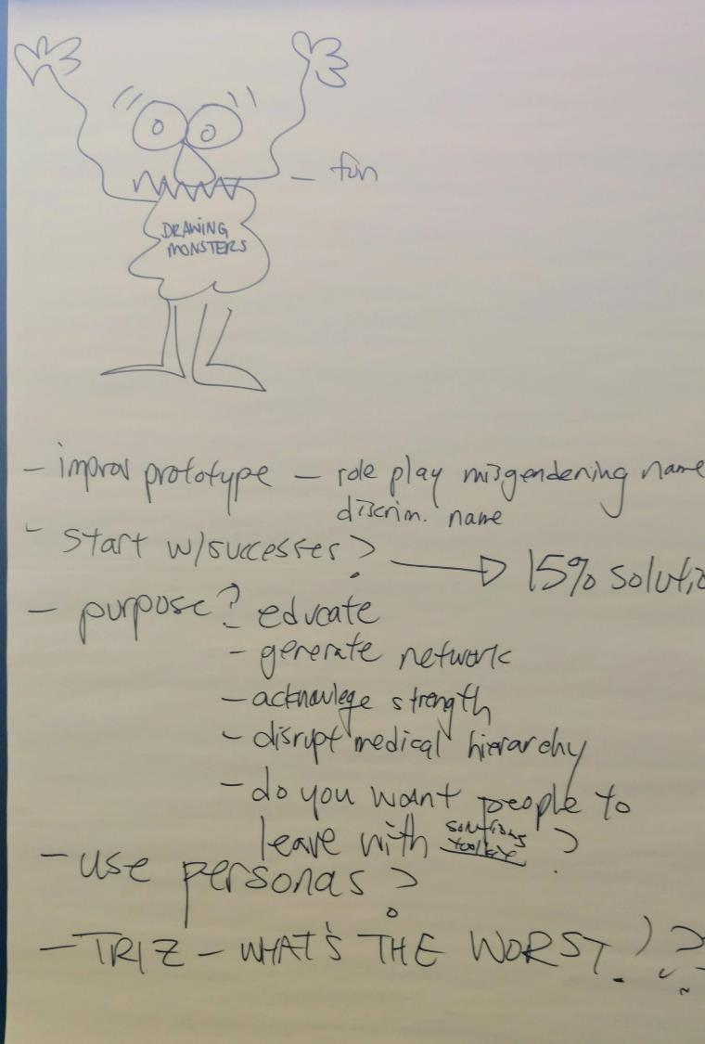
Debrief
What, So What, Now What?
http://www.liberatingstructures.com/9-what-so-what-now-what-w/

Slide 26
What³ Debrief Together, look back on progress and decide what adjustments are needed
Reflect on (the LS Activities you have experienced so far...)
WHAT?
What facts, data, & observations stand out?
Notes:
Make sure you really DIG into WHAT. Without those keen observations, So What and Now What can fall flat. This is a place to be lovingly tough.

Slide 27
What³ Debrief Together, look back on progress and decide what adjustments are needed
Reflect on the LS Activities you have experienced so far...
WHAT?
What facts, data, & observations stand out?
SO WHAT?
How do you explain those facts? Assumptions? Patterns? What is important?

Slide 28
What³ Debrief Together, look back on progress and decide what adjustments are needed
Reflect on the LS Activities you have experienced so far...
WHAT?
What facts, data, & observations stand out?
SO WHAT?
How do you explain those facts? Assumptions? Patterns? What is important?
NOW WHAT?
What action may help you move forward? Who else should be here?

Slide 29
What³
Invitation
What happened? So What? Now What?
Space, Materials
Unlimited number of groups, chairs, paper, flip chart
Step Sequence
Sequentially work through 3 questions
WWW
Together, Look Back on Progress to Date and Decide What Adjustments Are Needed
Groups Configured
Individuals, small groups, whole
Everyone included. Small groups give voice to all. Facilitate to focus on 1 question at a time.
Participation Distributed
Notes:
What, So What, Now What? W³
Together, Look Back on Progress to Date and Decide What Adjustments Are Needed (45 min.)
What is made possible? You can help groups reflect on a shared experience in a way that builds understanding and spurs coordinated action while avoiding unproductive conflict. It is possible for every voice to be heard while simultaneously sifting for insights and shaping new direction. Progressing in stages makes this practical—from collecting facts about What Happened to making sense of these facts with So What and finally to what actions logically follow with Now What. The shared progression eliminates most of the misunderstandings that otherwise fuel disagreements about what to do. Voila!
Five Structural Elements – Min Specs
1. Structuring Invitation
After a shared experience, ask, “WHAT? What happened? What did you notice, what facts or observations stood out?” Then, after all the salient observations have been collected, ask, “SO WHAT? Why is that important? What patterns or conclusions are emerging? What hypotheses can you make?” Then, after the sense making is over, ask, “NOW WHAT? What actions make sense?”
2. How Space Is Arranged and Materials Needed
Unlimited number of groups
Chairs for people to sit in small groups of 5-7; small tables are optional
Paper to make lists
Flip chart may be needed with a large group to collect answers
Talking object * (optional)
3. How Participation Is Distributed
Everyone is included
Everyone has an equal opportunity to contribute at each table
Small groups are more likely to give voice to everyone if one person facilitates and keeps everybody working on one question at a time
4. How Groups Are Configured
Individuals
Groups of 5-7
Whole group
Groups can be established teams or mixed groups
5. Sequence of Steps and Time Allocation
If needed, describe the sequence of steps and show the Ladder of Inference (see below). If the group is 10–12 people or smaller, conduct the debrief with the whole group. Otherwise, break the group into small groups.
First stage: WHAT? Individuals work 1 min. alone on “What happened? What did you notice, what facts or observations stood out?” then 2–7 min. in small group. 3–8 min. total.
Salient facts from small groups are shared with the whole group and collected. 2–3 min.
If needed, remind participants about what is included in the SO WHAT? question.
Second stage: SO WHAT? People work 1 min alone on “Why is that important? What patterns or conclusions are emerging? What hypotheses can I/we make?” then 2–7 min. in small group. 3–8 min. total.
Salient patterns, hypotheses, and conclusions from small groups are shared with the whole group and collected. 2–5 min.
Third stage: NOW WHAT? Participants work 1 min. alone on “Now what? What actions make sense?” then 2–7 min. in small group. 3–8 min. total.
Actions are shared with the whole group, discussed, and collected. Additional insights are invited. 2–10 min.
WHY? Purposes
Build shared understanding of how people develop different perspectives, ideas, and rationales for actions and decisions
Make sure that learning is generated from shared experiences: no feedback = no learning
Avoid repeating the same mistakes or dysfunctions over and over
Avoid arguments about actions based on lack of clarity about facts or their interpretation
Eliminate the tendency to jump prematurely to action, leaving people behind
Get all the data and observations out on the table first thing for everyone to start on the same page
Honor the history and the novelty of what is unfolding
Build trust and reduce fear by learning together at each step of a shared experience
Make sense of complex challenges in a way that unleashes action
Experience how questions are more powerful than answers because they invite active exploration
Tips and Traps
Practice, practice, practice … then What, So What, Now What? will feel like breathing
Check with small groups to clarify appropriate answers to each question (some groups get confused about what fits in each category) and share examples of answers with the whole group if needed
When sharing with the whole group, collect one important answer at a time. Don't try to collect answers from each group or invite a long repetitive list from a single group. Seek out unique anwsers that are full of meaning.
Intervene quickly and clearly when someone jumps up the Ladder of Inference
Don't jump over the So What? stage too quickly. It can be challenging for people to link observations directly to patterns. It is the most difficult of the three Whats. Use the Ladder of Inference as a reminder of the logical steps "up the ladder" from observations to action.
Appreciate candid feedback and recognize it
Build in time for the debrief—don’t trivialize it, don’t rush it
Make it the norm to debrief with W³, however quickly, at the end of everything
Riffs and Variations
Use a talking obect for each round. It slows and deepens the productivity of W³
For the What? question, spend time sifting items that arise into three categories: facts with evidence, shared observations, feelings, and opinions
Add a What If? question between So What? and Now What?
For the So What? Question, sift items into patterns, conclusions, hypotheses/educated guesses, beliefs
Invite a small group of volunteers to debrief in front of the whole room. People with strong reactions and diverse roles should be invited to join in.
Examples
For drawing out the history and meaning of the events prior to your gathering, start a meeting with W³
For debriefing any meeting topic that generates complex or controversial responses
For groups with people who have strong opinions or individuals who dominate the conversation
For groups with people who have difficulty listening to others with different backgrounds
For use in place of a leader “telling” people what to think, what conclusions to draw, or what actions to take (often unintentionally)
As a standard discipline at the end of all meetings
Right after a shocking event
More on talking obects: a taking object can be anything you are able to pass from one person to another. When you have it, you are invited to speak. When you don’t, you are invited to listen. Natural objects that are enjoyable to hold in your hands. Playful art objects can also help lighten the mood for very serious topics. In a pinch, a book or pen will serve.
Attribution: Liberating Structure developed by Henri Lipmanowicz and Keith McCandless. Chris Argyris introduced the “Ladder of Inference” in Reasoning, Learning, and Action: Individual and Organizational (San Francisco: Jossey-Bass, 1982). Peter Senge popularized it in The Fifth Discipline: The Art and Practice of the Learning Organization (New York: Doubleday, 1990).
Collateral Material
Below: Presentation materials for introducing What, So What, Now What?

Slide 30
Notes:
See also https://www.mindtools.com/pages/article/newTMC_91.htm

